Slide 1
MIT STUDENT HUB WEBSITE
1.Kirpalpreet kaur
2.Amal Jose
3.Tapan Vyas

Slide 2
MIT STUDENT HUB WEBSITE
MIT had an official website with academic details and information regarding the campus.
Lacks a place where students of MIT can share information regarding job opportunities (either full time or part time jobs), accommodation availabilities , transportation facilities (like carpooling), social as well as cultural events and activities.

Slide 3
AIM
Develop a website for MIT students to find and share opportunities around them to strengthen their social life.

Slide 4
SCOPE
Convey adequate information's to find opportunities for students of MIT.

Slide 5
MEASURABLE ORGANISATIONAL VALUE
Social and academic impact
Reduce effort in finding job availabilities, accommodation facilities and transportation facilities
Improves social life and cultural exchange
Easier access to new students
More important for internationals

Slide 6
RESEARCH QUESTION AND PROPOSAL
An interactive website for students of MIT
Can MIT student hub website improve the social life of students by offering better opportunities?

Slide 7

EXISTING WEBSITES
University of Otago
Accomodation facilities can be shared
Job related information
Details regarding room sharing and rents

Slide 8
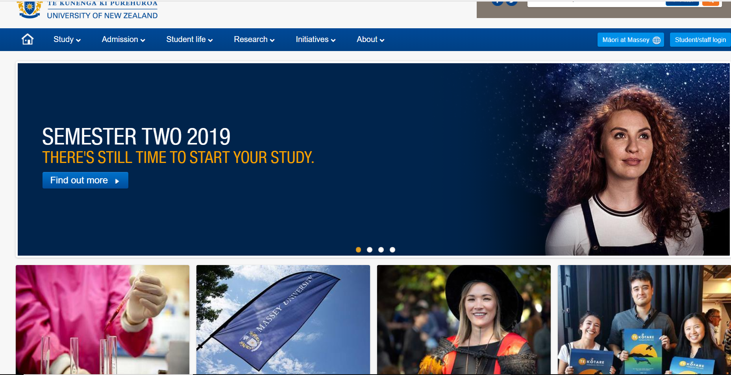
EXISTING WEBSITES
Massey University
Tools to familiarize with campus
Information's about activities

Slide 9
SOFTWARE TECHNOLOGIES
C# ,VISUAL STUDIO –backend development
HTML,BOOTSTRAP and JAVASCRIPT –frontend design
SQL SERVER 17- database

Slide 10
SOFTWARE METHODOLOGY
Agile software development method
Sprint ,time limits
Progress with the time frame allocated.
Self organised team

Slide 11
SOFTWARE METHODOLOGY
Utilising acceptable practices of extreme programming
1. The planning game
2. Simple design
3. Testing
4. Pair programming
5. Coding standard

Slide 12
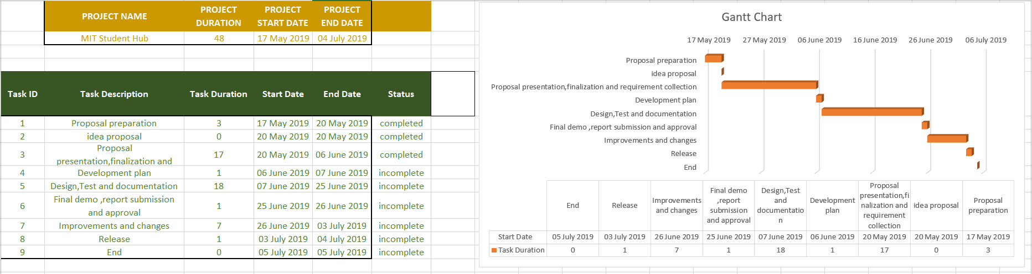
PLANNING(GANTT CHART)

Slide 13
ROLES OF TEAM MEMBERS
AMAL JOSE | TAPAN VYAS | KIRPALPREET KAUR
FRONTEND DESIGN BACKEND CODING DOCUMENTATION | BACKEND CODING DATABASE DESIGN DOCUMENTATION | FRONTEND DESIGN SITE CONTENT MANAGEMENT DOCUMENTATION

Slide 14
THANK YOU

